Slide 1



Coordination in Distributed Multi-User High-Performance Dense Networks (5G Synchronization: October Update)

Slide 2
Outline
Recap
Proposed phase noise estimation and cancellation methods
: compleixty analysis
Initial Implementation results of the algorithm
Key function blocks
Synthesis results and comparision
System-hardware co-design
Phase noise in distributed massiv MIMO
Discussion on post-silicon verification and future plan

Slide 3
Recap

Slide 4
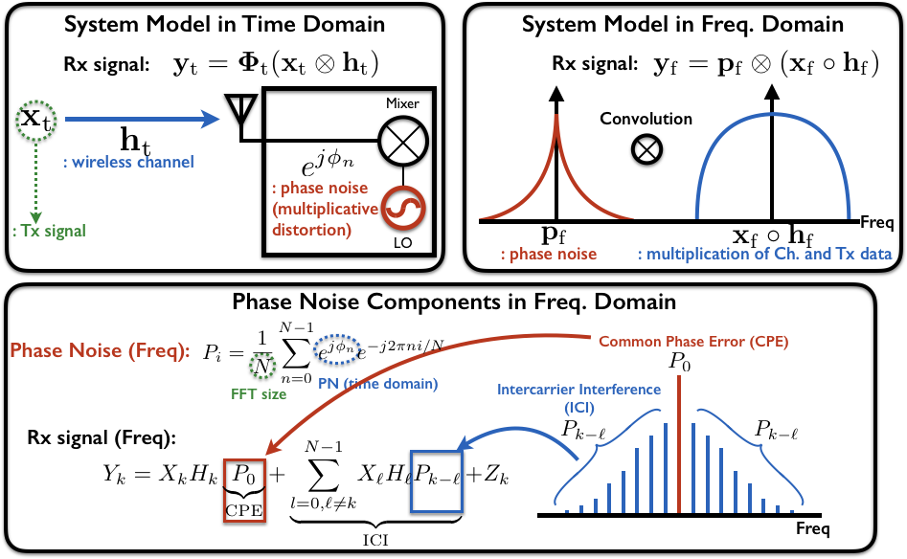
Background: System Model with Phase Noise (PN)

Slide 5
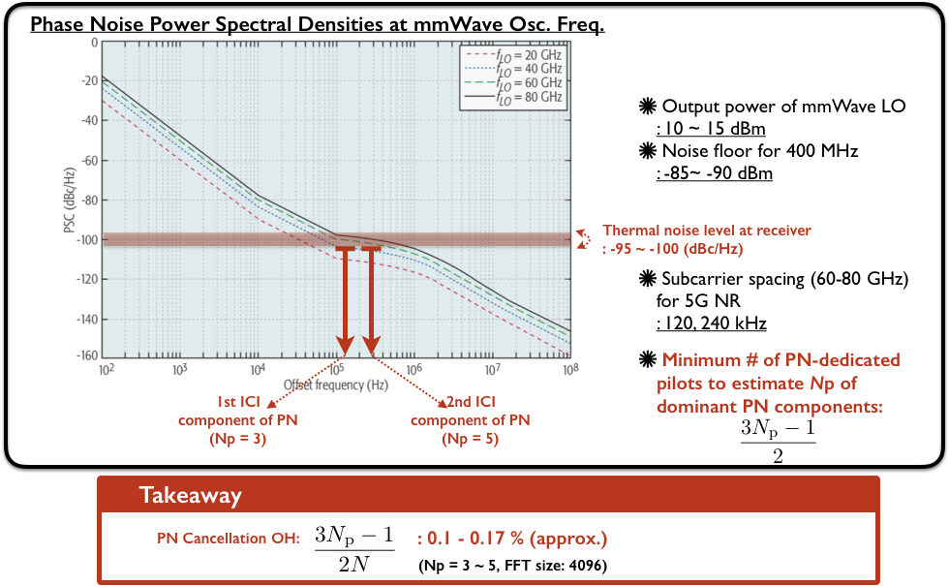
5G NR with Phase Noise
From [Waveform and Numerology to Support 5G Services and Requirements]

Slide 6
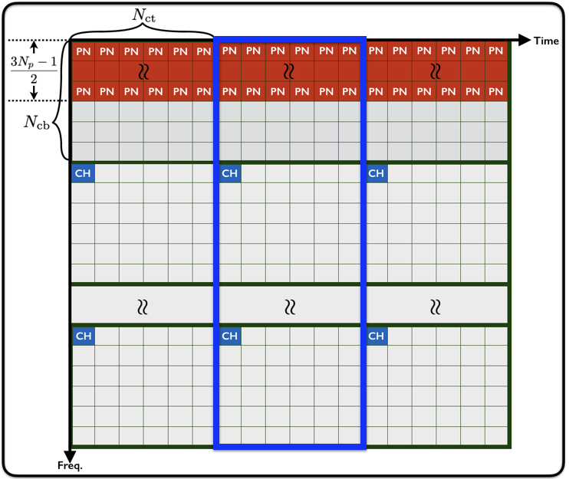
Resource Allocation

Slide 7
Main steps in the algorithm
1st step: Estimation of Phase-Noise (PN)-Affected Channel
- Estimation by using PN-dedicated pilot
2nd step: Separation of CH and PN components
- Deconvolution
3rd step: Estimation of Intercarrier Interference(ICI)-Free Channel
- Estimation by using ICI-dedicated pilot

Slide 8
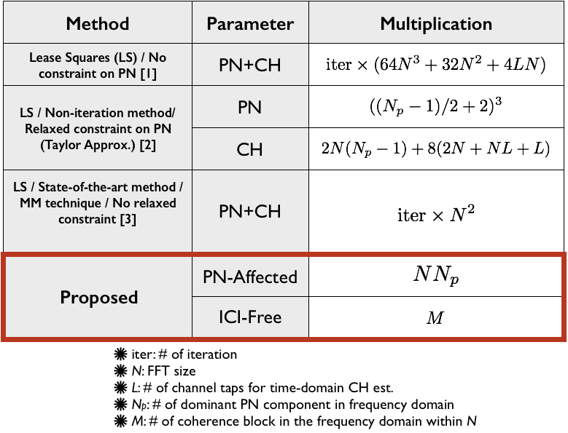
Complexity Comparison

Slide 9
Initial Implementation

Slide 10
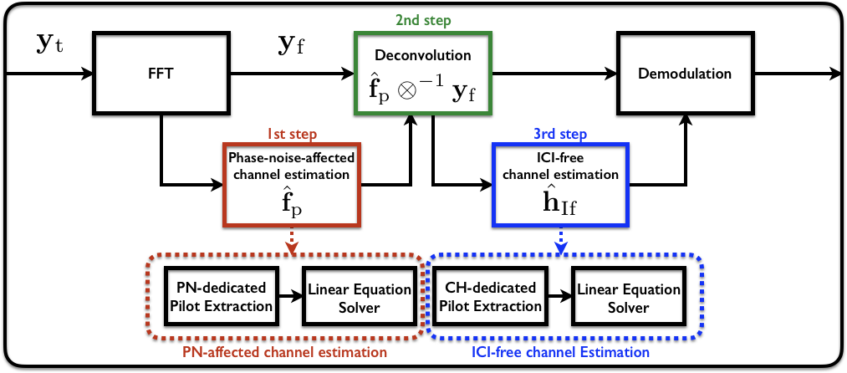
Overall Architecture

Slide 11
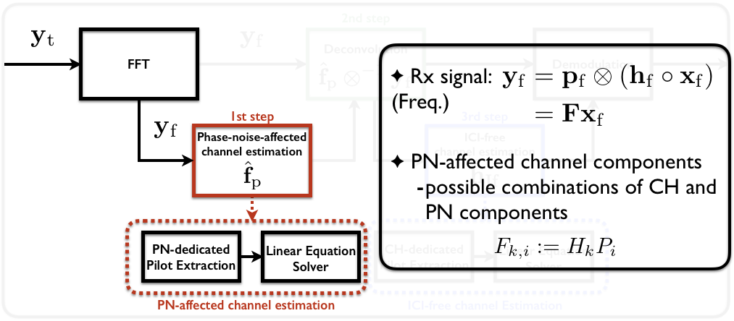
1st Step: Estimation of PN-Affected Channel

Slide 12
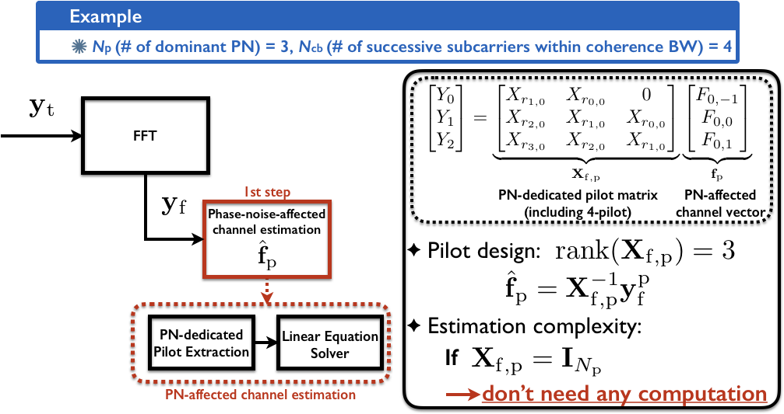
1st Step: Estimation of PN-Affected Channel

Slide 13
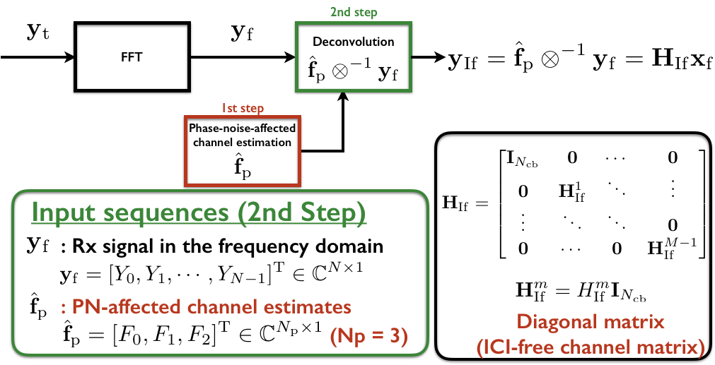
2nd Step: Separation of CH and PN components

Slide 14
Time-domain compensation
Very long feedback path
Long processing latency
+ phase noise estimation per OFDM symbol
Large memory consumption
Low throughput

Slide 15
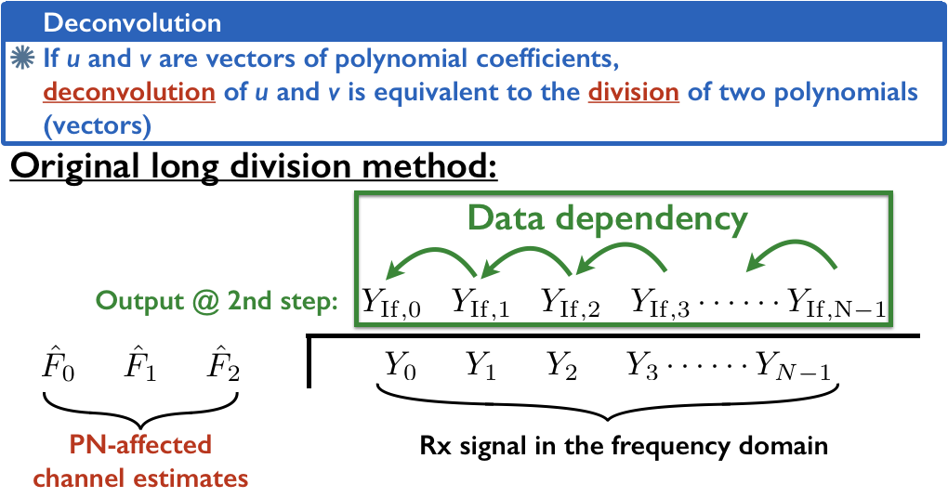
Polynomial division/deconvolution

Slide 16

Block diagram (3-tap ICI)
Limited throughput due to the data dependency (better than feeding back to time domain)
Very low hardware cost
$$c_{0}=\frac{1}{F_{0}}$$
$$Y_{IF,k}=c_{0}\left(Y_{k}−{Y_{IF,k−1}F}_{2}−{Y_{IF,k−2}F}_{1}\right)$$

Slide 17
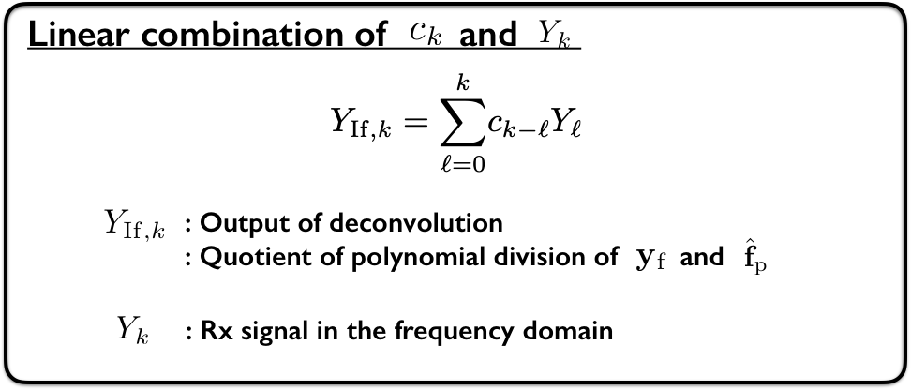
Equivalent model of deconvolution

Slide 18
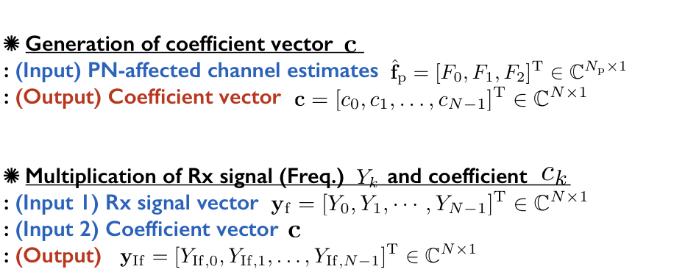
Parallel polynomial division

Slide 19




Block diagram (2-way parallell)
$$c_{0}=\frac{1}{F_{0}}$$
$$c_{1}=\frac{F_{1}}{F_{0}^{2}}$$
$$Y_{IF,i}={c_{0}(Y}_{i}−{Y_{IF,i−2}F}_{2}−{Y_{IF,i−1}F}_{1})$$
$$Y_{IF,i+1}=\begin{matrix}{c_{1}(Y}_{i}−{Y_{IF,i−2}F}_{2}−{Y_{IF,i−1}F}_{1}) \\ −{c_{0}(Y}_{i+1}−{Y_{IF,i−1}F}_{2}) \end{matrix}$$

Slide 20
Throughput-complexity trade-off
Synthesis results using 28nm technology
Parallelism | Clock frequency | Throughput | Gate count | Area efficiency
1 | 500MHz | 250MS/s | 18.8k | 13.3MS/s/kG
2 | 500MHz | 500MS/s | 44.7k | 11.2MS/s/kG
4 | 500MHz | 1GS/s | 104.2k | 9.6MS/s/kG
8 | 500MHz | 2GS/s | 211k | 9.4MS/s/kG

Slide 21
Timing diagram
OFDM i
OFDM i+1
FFT Output
PN-chan. Est.
Coe. preCalc.
5clk
Deconvol.
2clk
PN-free Chan. Est.
2clk
Equ.
2clk

Slide 22
System-level consideration

Slide 23
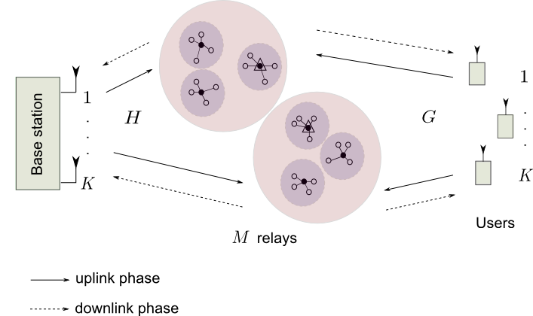
Correlated/un-correlated phase noise in distributed massive MIMO systems
Three levels of cooperation:
Group: share both receive symbols and CSI, but phase noise can be correlated
the total # nodes is128, K=2, chang the # nodes within each group
Phase noise uniformly distributed between [-phi/2,phi/2]
cluster
group

Slide 24
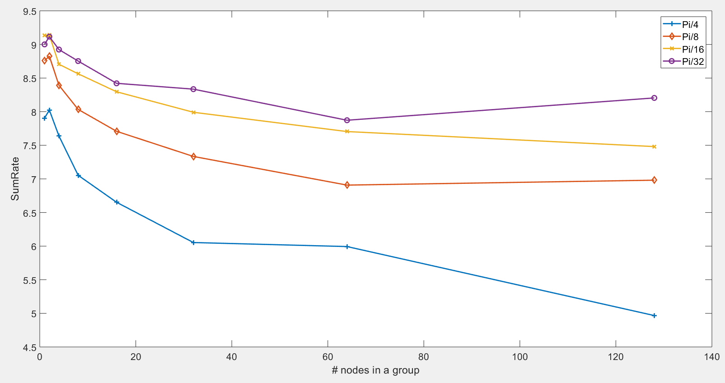
Correlated/un-correlated phase noise in distributed massive MIMO systems
With matched filtering processing, 12dB SNR
Uncorrelated phase noise can be averaged out by distributed array processing
Phi=pi/32
GroupSize=32
Phi=pi/8
GroupSize=4

Slide 25
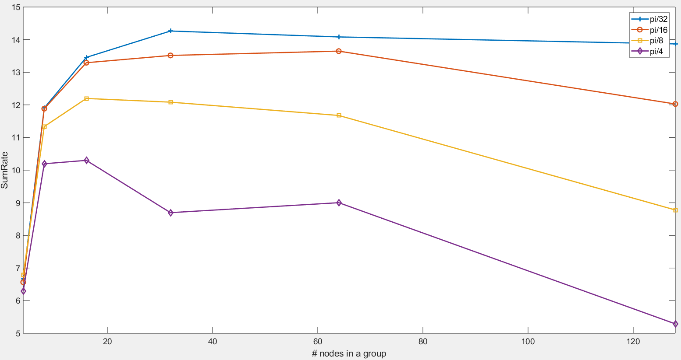
Correlated/un-correlated phase noise in distributed massive MIMO systems
With zero-forcing processing, 12dB SNR
Trade-off between phase noise mitigation and inter-UE inteference cancellation

Slide 26
Discussion on tape-out

